Slide 1
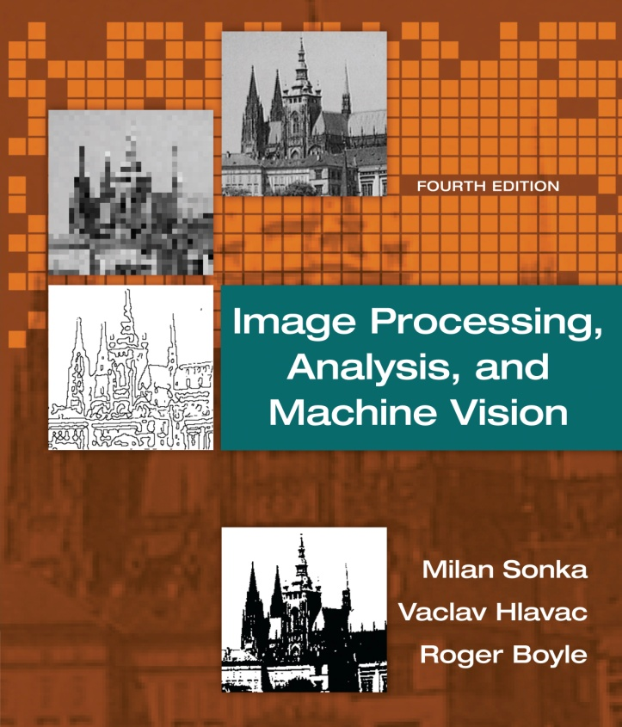

Chapter 3
Image Processing, Analysis, and Machine Vision, 4th Edition Sonka, Hlavac & Boyle
The image, its mathematical and physical background

Slide 2
Outline
Image Processing, Analysis, and Machine Vision, 4th Edition Sonka, Hlavac & Boyle
Overview
Linear integral transforms
Images as linear systems
Introduction to linear integral transforms
Fourier transform
Sampling and the Shannon constraint
Wavelet transform
Images as stochastic process
Image formation physics

Slide 3
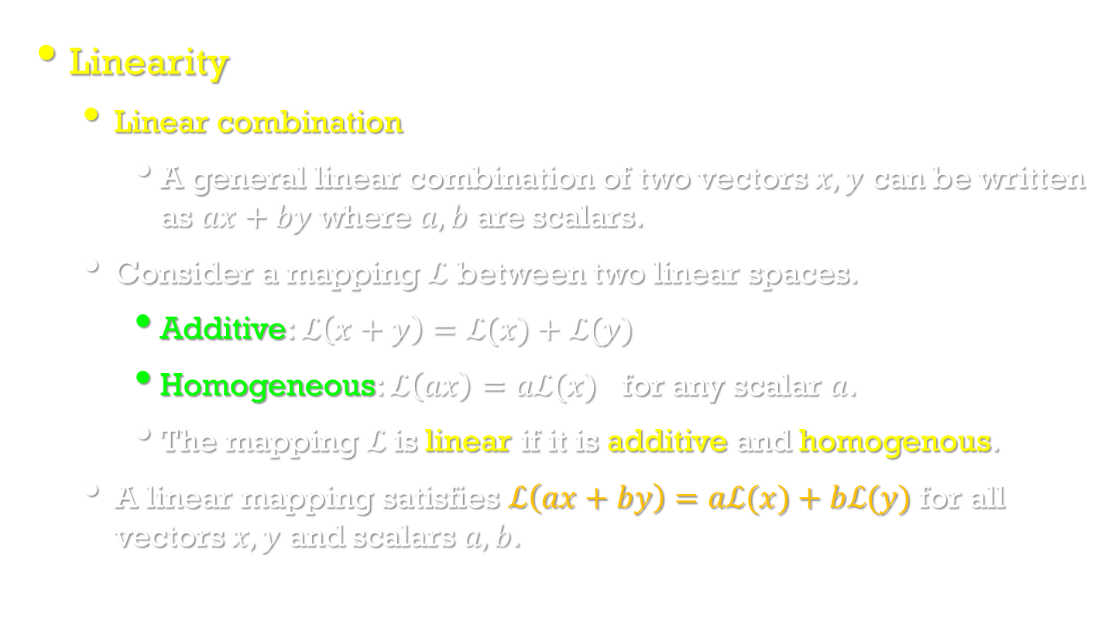
Overview
Image Processing, Analysis, and Machine Vision, 4th Edition Sonka, Hlavac & Boyle
Linearity
Linear combination
A general linear combination of two vectors $x,y$ can be written as $ax+by$ where $a,b$ are scalars.
Consider a mapping $ℒ$ between two linear spaces.
Additive: $ℒ\left(x+y\right)=ℒ(x)+ℒ(y)$
Homogeneous: $ℒ\left(ax\right)=aℒ(x)$ for any scalar $a$.
The mapping $ℒ$is linear if it is additive and homogenous.
A linear mapping satisfies $ℒ\left(ax+by\right)=aℒ(x)+bℒ(y)$ for all vectors $x,y$ and scalars $a,b$.

Slide 4
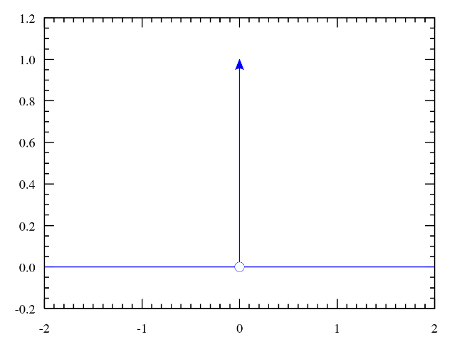
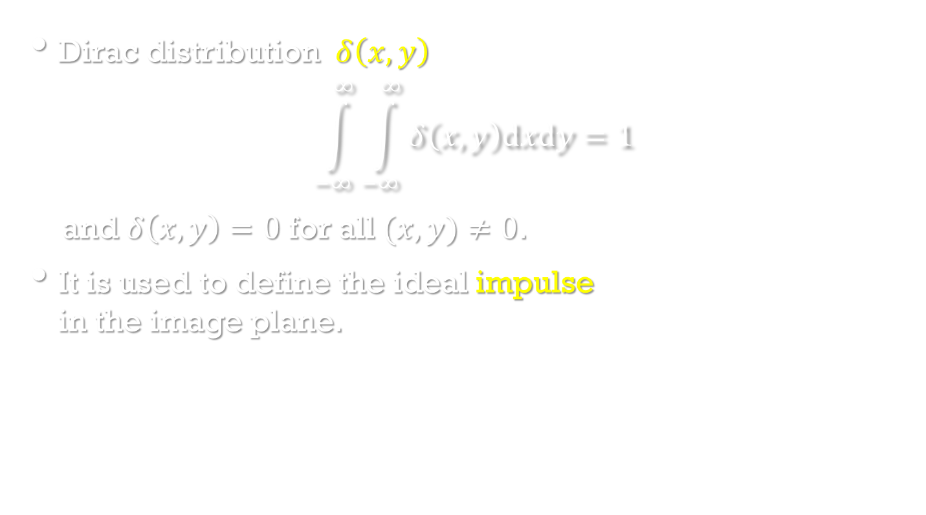
The Dirac distribution and convolution
Image Processing, Analysis, and Machine Vision, 4th Edition Sonka, Hlavac & Boyle
Dirac distribution $δ\left(x,y\right)$
$$\int_{−∞}^{∞}{\int_{−∞}^{∞}{δ\left(x,y\right)dxdy}}=1$$
and $δ\left(x,y\right)=0$ for all $(x,y)≠0$.
It is used to define the ideal impulse in the image plane.
https://zh.wikipedia.org/wiki/%E7%8B%84%E6%8B%89%E5%85%8B%CE%B4%E5%87%BD%E6%95%B0
PS. 從純數學的觀點來看，狄拉克δ函數並非嚴格意義上的函數，因為任何在擴展實數線上定義的函數，如果在一個點以外的地方都等於零，其總積分必須為零。δ函數只有在出現在積分以內的時候才有實質的意義。根據這一點，δ函數一般可以當做普通函數一樣使用。

Slide 5
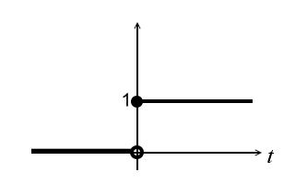
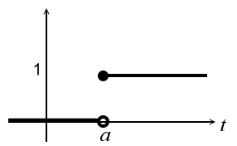
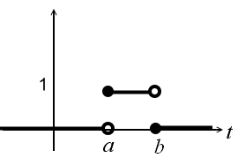
Dirac Delta Function
Heaviside step function:
Pulse:

Slide 6
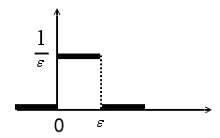
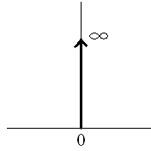
Impulse:
Dirac delta function:
2D delta function:

Slide 7
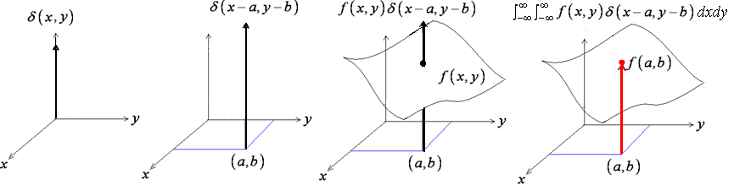
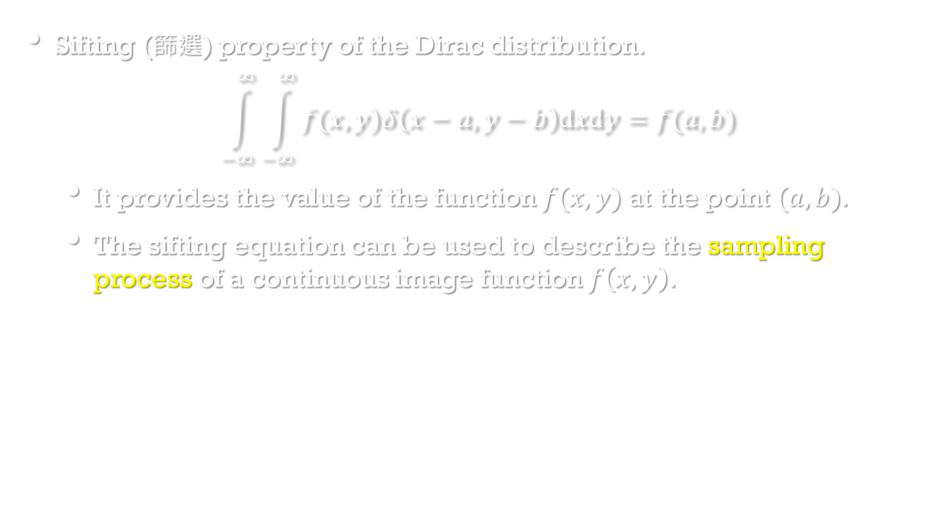
The Dirac distribution and convolution
Image Processing, Analysis, and Machine Vision, 4th Edition Sonka, Hlavac & Boyle
Sifting (篩選) property of the Dirac distribution.
$$\int_{−∞}^{∞}{\int_{−∞}^{∞}{f(x,y)δ\left(x−a,y−b\right)dxdy}}=f(a,b)$$
It provides the value of the function $f(x,y)$at the point $(a,b)$.
The sifting equation can be used to describe the sampling process of a continuous image function $f\left(x,y\right)$.

Slide 8
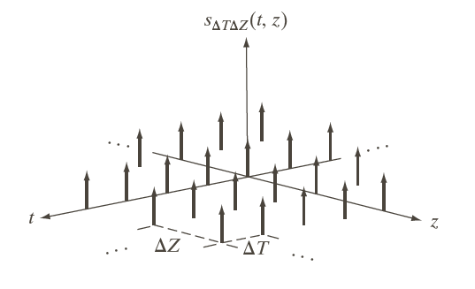
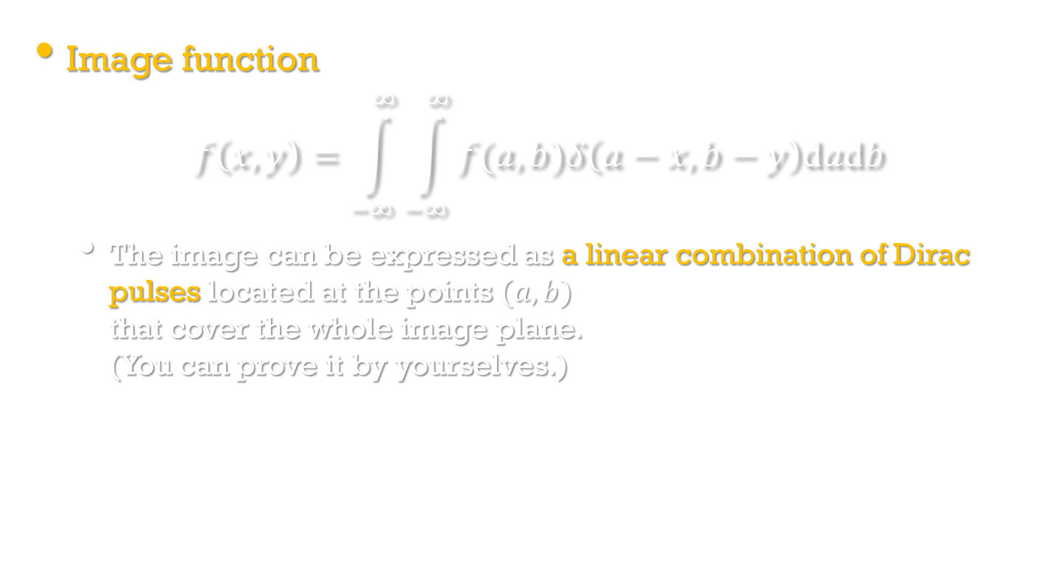
The Dirac distribution and convolution
Image Processing, Analysis, and Machine Vision, 4th Edition Sonka, Hlavac & Boyle
Image function
$$f\left(x,y\right)=\int_{−∞}^{∞}{\int_{−∞}^{∞}{f(a,b)δ\left(a−x,b−y\right)dadb}}$$
The image can be expressed as a linear combination of Dirac pulses located at the points $(a,b)$ that cover the whole image plane. (You can prove it by yourselves.)

Slide 9
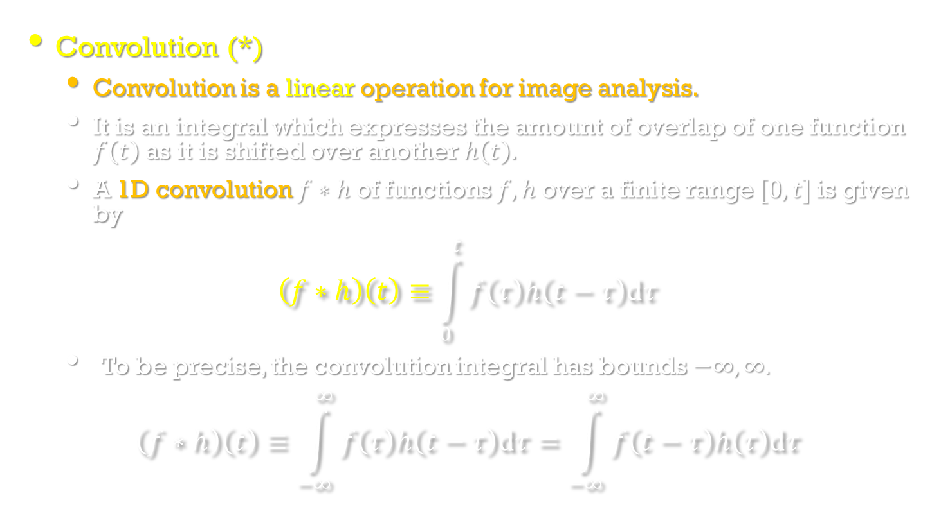
The Dirac distribution and convolution
Image Processing, Analysis, and Machine Vision, 4th Edition Sonka, Hlavac & Boyle
Convolution (*)
Convolution is a linear operation for image analysis.
It is an integral which expresses the amount of overlap of one function $f\left(t\right)$ as it is shifted over another $h\left(t\right)$.
A 1D convolution $f∗h$ of functions $f,h$ over a finite range $[0,t]$is given by
$$\left(f∗h\right)\left(t\right)≡\int_{0}^{t}{f\left(τ\right)h\left(t−τ\right)dτ}$$
To be precise, the convolution integral has bounds $−∞,∞.$
$$\left(f∗h\right)\left(t\right)≡\int_{−∞}^{∞}{f\left(τ\right)h\left(t−τ\right)dτ}=\int_{−∞}^{∞}{f\left(t−τ\right)h\left(τ\right)dτ}$$

Slide 10
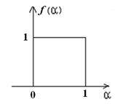
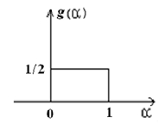
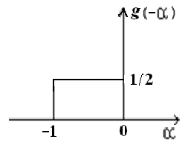
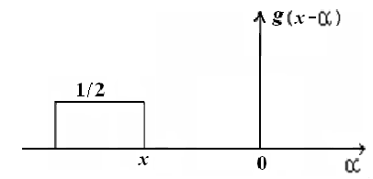
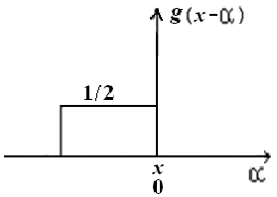
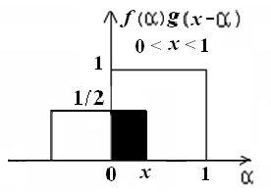
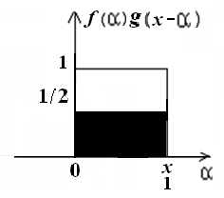
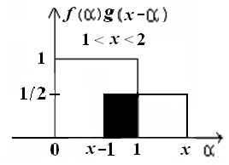
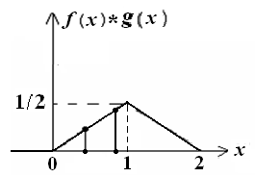
Convolution

Slide 11


Convolution

Slide 12
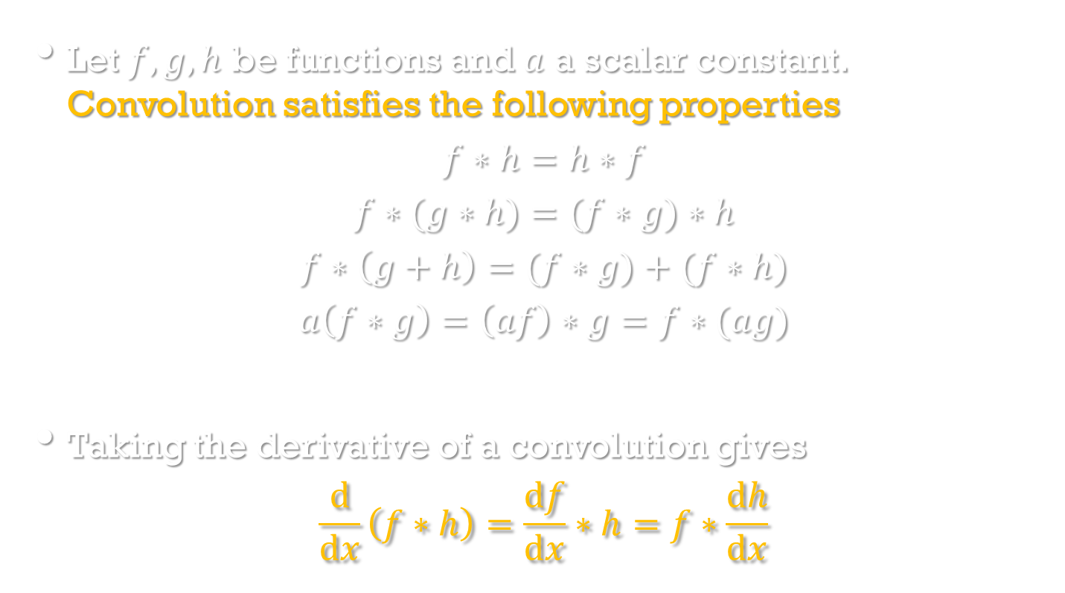
The Dirac distribution and convolution
Image Processing, Analysis, and Machine Vision, 4th Edition Sonka, Hlavac & Boyle
Let $f,g,h$ be functions and $a$ a scalar constant. Convolution satisfies the following properties
$$f∗h=h∗f$$
$$f∗(g∗h)=(f∗g)∗h$$
$$f∗\left(g+h\right)=(f∗g)+(f∗h)$$
$$a\left(f∗g\right)=\left(af\right)∗g=f∗(ag)$$
Taking the derivative of a convolution gives
$$\frac{d}{dx}\left(f∗h\right)=\frac{df}{dx}∗h=f∗\frac{dh}{dx}$$

Slide 13
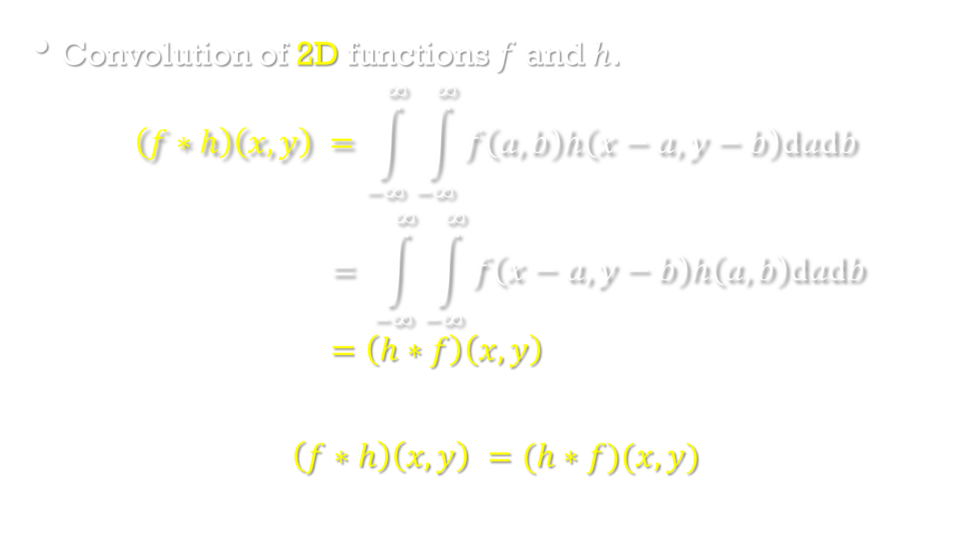
The Dirac distribution and convolution
Image Processing, Analysis, and Machine Vision, 4th Edition Sonka, Hlavac & Boyle
Convolution of 2D functions $f$ and $h$.
$$\left(f∗h\right)\left(x,y\right) =\int_{−∞}^{∞}{\int_{−∞}^{∞}{f\left(a,b\right)h\left(x−a,y−b\right)dadb}}$$
$$= \int_{−∞}^{∞}{\int_{−∞}^{∞}{f\left(x−a,y−b\right)h\left(a,b\right)dadb}}$$
$$=\left(h∗f\right)\left(x,y\right)$$
$$\left(f∗h\right)\left(x,y\right) =(h∗f)(x,y)$$

Slide 14
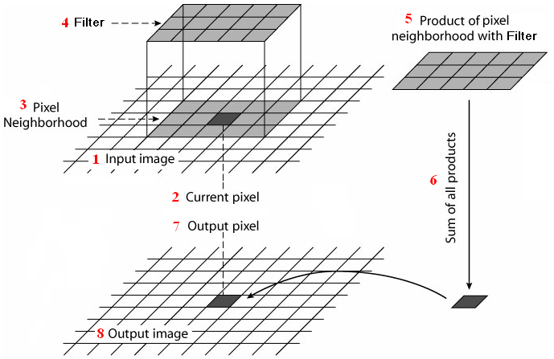
The Dirac distribution and convolution
Image Processing, Analysis, and Machine Vision, 4th Edition Sonka, Hlavac & Boyle
Discrete convolution

Slide 15
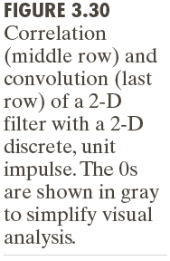
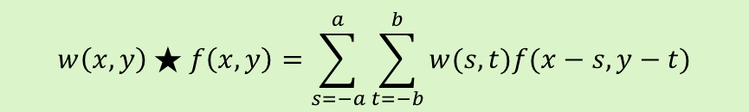
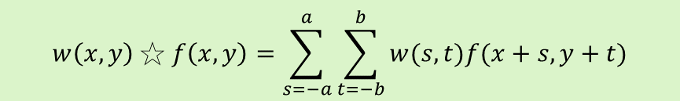
Spatial Correlation and Convolution
Two linear spatial filters: Correlation VS Convolution
A 2D example
$$w\left(x,y\right)☆f\left(x,y\right)=\sum_{s=−a}^{a}{\sum_{t=−b}^{b}{w(s,t)f(x+s,y+t)}}$$
$$w\left(x,y\right)★f\left(x,y\right)=\sum_{s=−a}^{a}{\sum_{t=−b}^{b}{w(s,t)f(x−s,y−t)}}$$

Slide 16
Spatial Correlation and Convolution

Slide 17
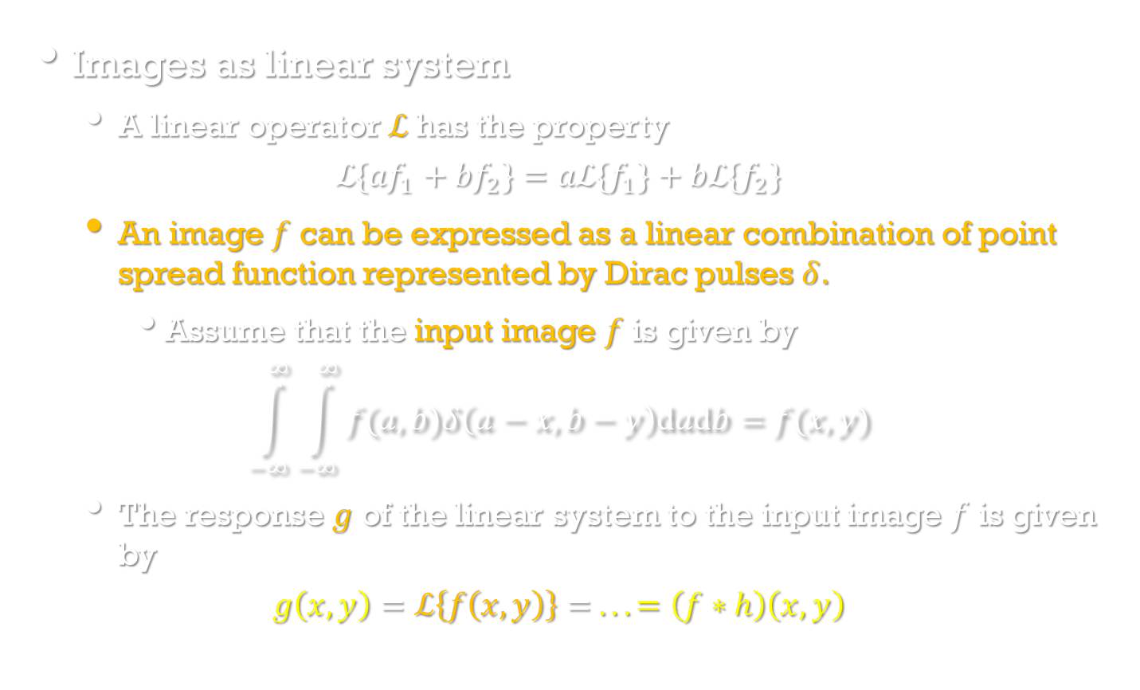
Linear integral transforms
Image Processing, Analysis, and Machine Vision, 4th Edition Sonka, Hlavac & Boyle
Images as linear system
A linear operator $ℒ$has the property
$$ℒ\{{af}_{1}+{bf}_{2}\}=aℒ\{f_{1}\}+bℒ\{f_{2}\}$$
An image $f$ can be expressed as a linear combination of point spread function represented by Dirac pulses $δ$.
Assume that the input image $f$ is given by
$$\int_{−∞}^{∞}{\int_{−∞}^{∞}{f(a,b)δ\left(a−x,b−y\right)dadb}}=f(x,y)$$
The response $g$ of the linear system to the input image $f$ is given by
$$g\left(x,y\right)=ℒ\left\{f\left(x,y\right)\right\}= ...=\left(f∗h\right)\left(x,y\right)$$

Slide 18
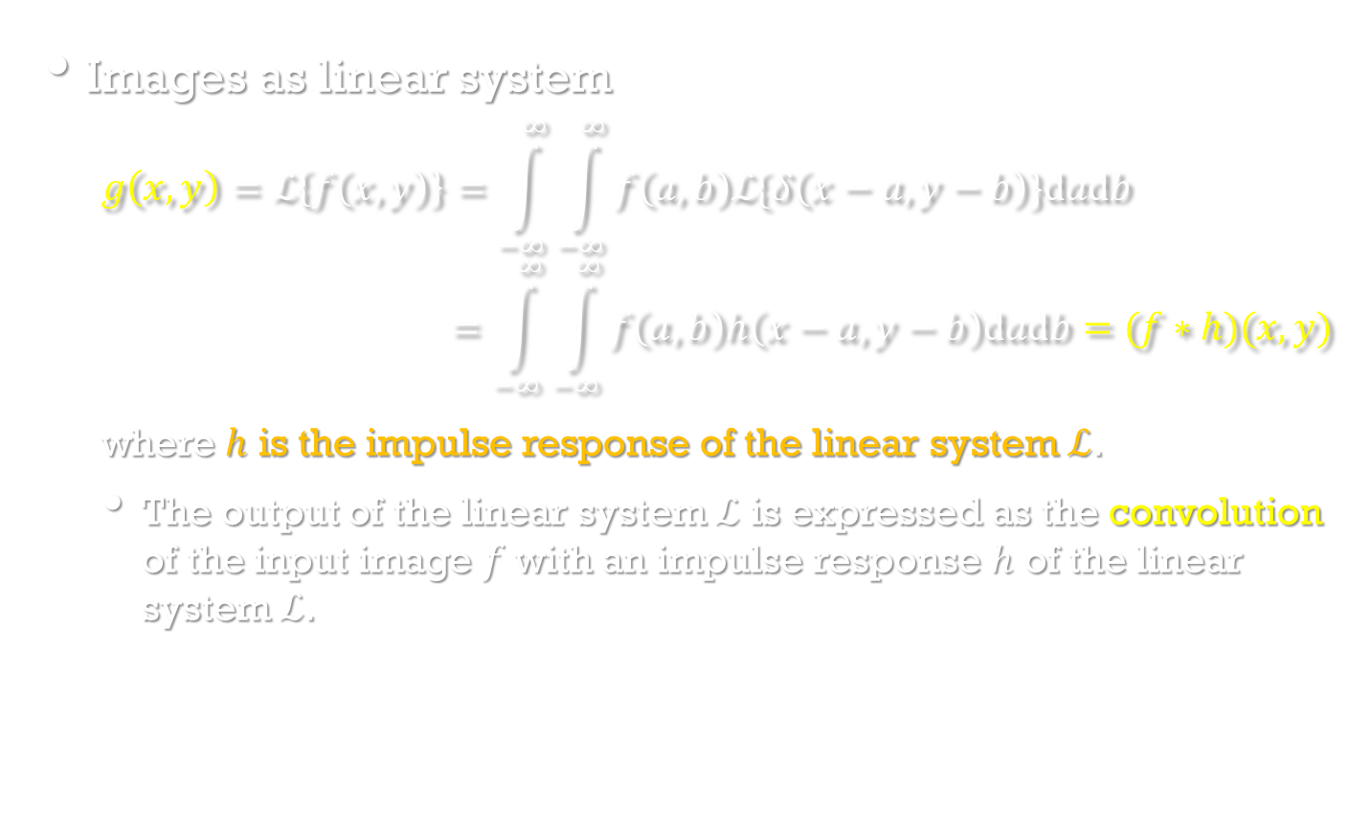
Linear integral transforms
Image Processing, Analysis, and Machine Vision, 4th Edition Sonka, Hlavac & Boyle
Images as linear system
$$g\left(x,y\right)=ℒ\left\{f\left(x,y\right)\right\}=\int_{−∞}^{∞}{\int_{−∞}^{∞}{f\left(a,b\right)ℒ\{δ\left(x−a,y−b\right)\}dadb}} \\ =\int_{−∞}^{∞}{\int_{−∞}^{∞}{f\left(a,b\right)h\left(x−a,y−b\right)dadb}=(f∗h)(x,y)}$$
where $h$ is the impulse response of the linear system $ℒ$.
The output of the linear system $ℒ$ is expressed as the convolution of the input image $f$ with an impulse response $h$ of the linear system $ℒ$.

Slide 19
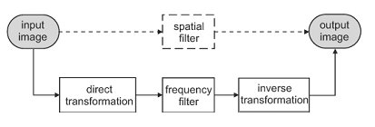
Introduction to linear integral transforms
Image Processing, Analysis, and Machine Vision, 4th Edition Sonka, Hlavac & Boyle
Image filtering
An application of a linear integral transform in image processing
Filtering can be performed in either spatial or frequency domains.
There is one-to-one mapping between the spatial and frequency domains.
For linear operations, these two ways should provide equivalent results.

Slide 20
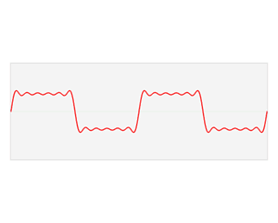
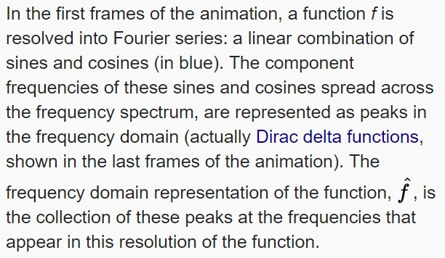
Fourier transform
https://en.wikipedia.org/wiki/Fourier_transform

Slide 21
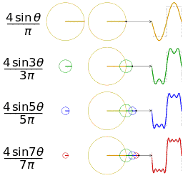
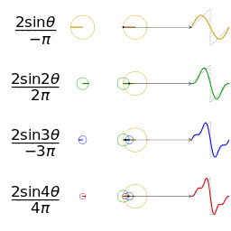
Fourier series
https://en.wikipedia.org/wiki/Fourier_series
Fourier series visualisation with d3.js.
https://bl.ocks.org/jinroh/7524988

Slide 22
Selective Filtering
http://slideplayer.com/slide/8267284/

Slide 23

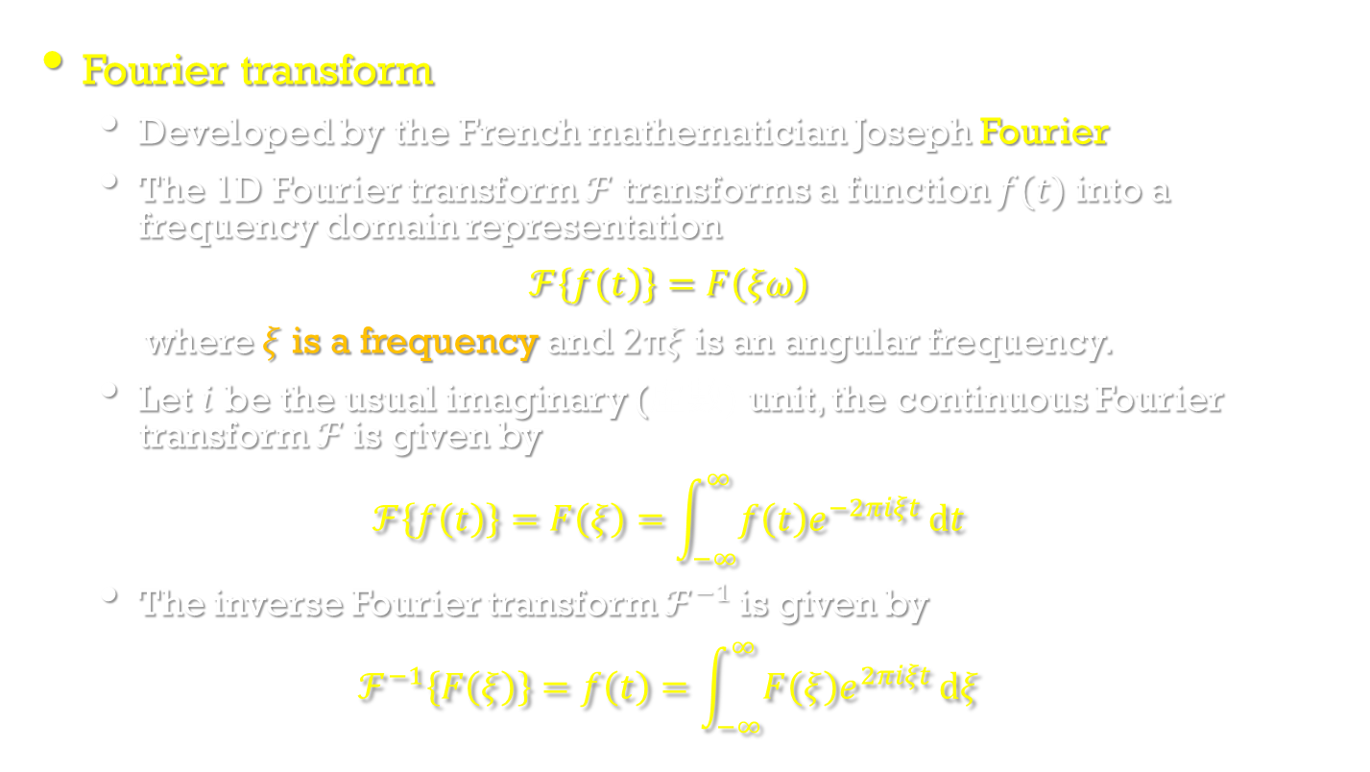
1D Fourier transform
Image Processing, Analysis, and Machine Vision, 4th Edition Sonka, Hlavac & Boyle
Fourier transform
Developed by the French mathematician Joseph Fourier
The 1D Fourier transform $ℱ$ transforms a function $f(t)$ into a frequency domain representation
$$ℱ\left\{f\left(t\right)\right\}=F\left(ξω\right)$$
where $ξ$ is a frequency and $2πξ$ is an angular frequency.
Let $i$ be the usual imaginary (虛數) unit, the continuous Fourier transform $ℱ$is given by
$$ℱ\left\{f\left(t\right)\right\}=F\left(ξ\right)=\int_{−∞}^{∞}{f\left(t\right)e^{−2πiξt}}dt$$
The inverse Fourier transform $ℱ^{−1}$is given by
$$ℱ^{−1}\left\{F\left(ξ\right)\right\}=f\left(t\right)=\int_{−∞}^{∞}{F\left(ξ\right)e^{2πiξt}}dξ$$
Ps. $e^{iω}=cosω+isinω$
https://en.wikipedia.org/wiki/Euler%27s_formula
https://zh.wikipedia.org/wiki/%E6%AC%A7%E6%8B%89%E5%85%AC%E5%BC%8F

Slide 24
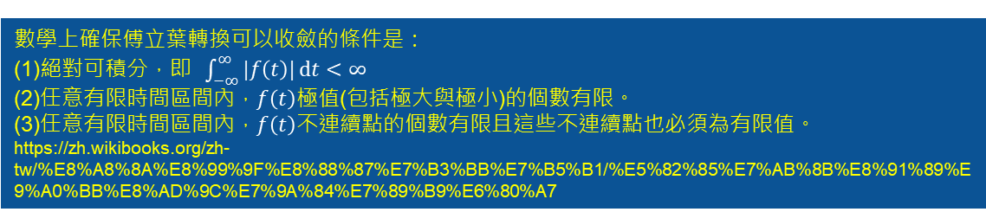
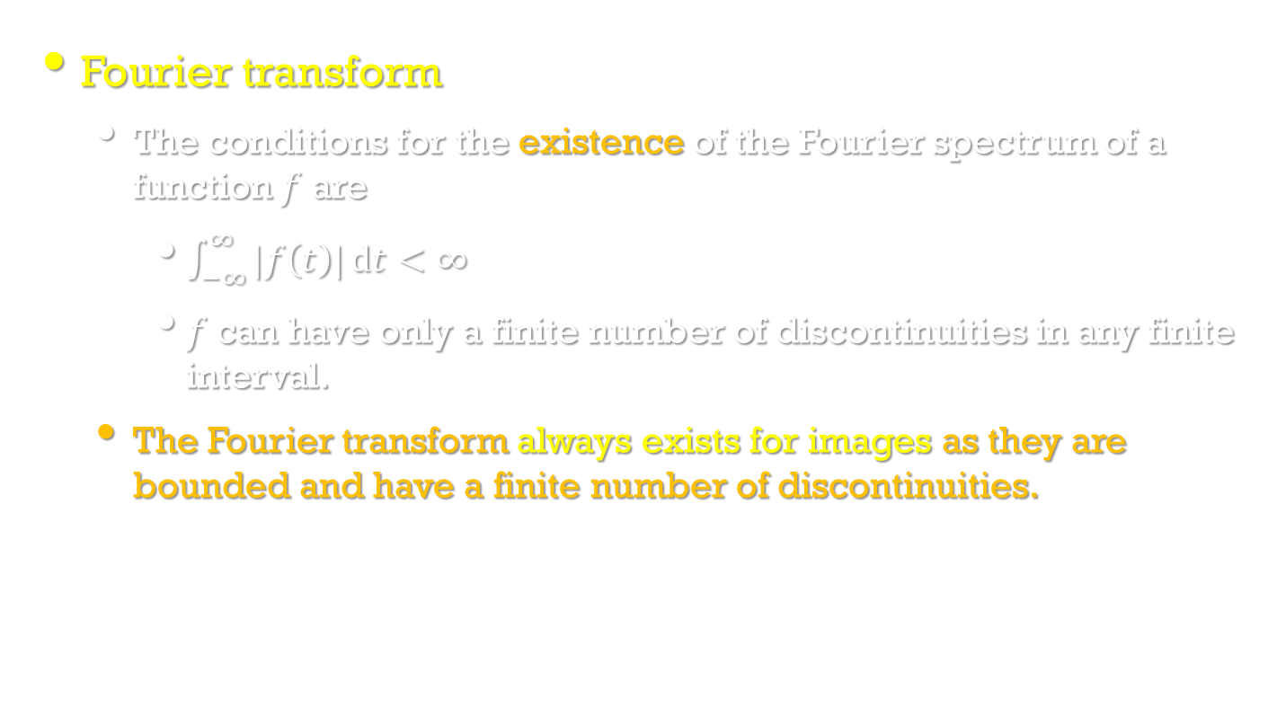
1D Fourier transform
Image Processing, Analysis, and Machine Vision, 4th Edition Sonka, Hlavac & Boyle
Fourier transform
The conditions for the existence of the Fourier spectrum of a function $f$ are
$\int_{−∞}^{∞}{|f\left(t\right)|}dt<∞$
$f$ can have only a finite number of discontinuities in any finite interval.
The Fourier transform always exists for images as they are bounded and have a finite number of discontinuities.
數學上確保傅立葉轉換可以收斂的條件是：
(1)絕對可積分，即 $\int_{−∞}^{∞}{|f\left(t\right)|}dt<∞$
(2)任意有限時間區間內，$f\left(t\right)$極值(包括極大與極小)的個數有限。
(3)任意有限時間區間內，$f\left(t\right)$不連續點的個數有限且這些不連續點也必須為有限值。
https://zh.wikibooks.org/zh-tw/%E8%A8%8A%E8%99%9F%E8%88%87%E7%B3%BB%E7%B5%B1/%E5%82%85%E7%AB%8B%E8%91%89%E9%A0%BB%E8%AD%9C%E7%9A%84%E7%89%B9%E6%80%A7

Slide 25
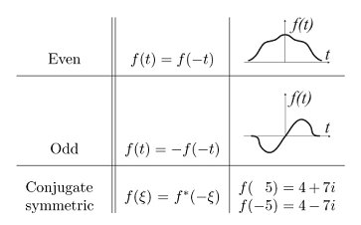
1D Fourier transform
Image Processing, Analysis, and Machine Vision, 4th Edition Sonka, Hlavac & Boyle
The Fourier transform exhibits predictable symmetries.
Notation of even, odd, and conjugate (共軛) symmetric function

Slide 26
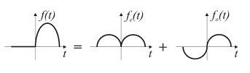
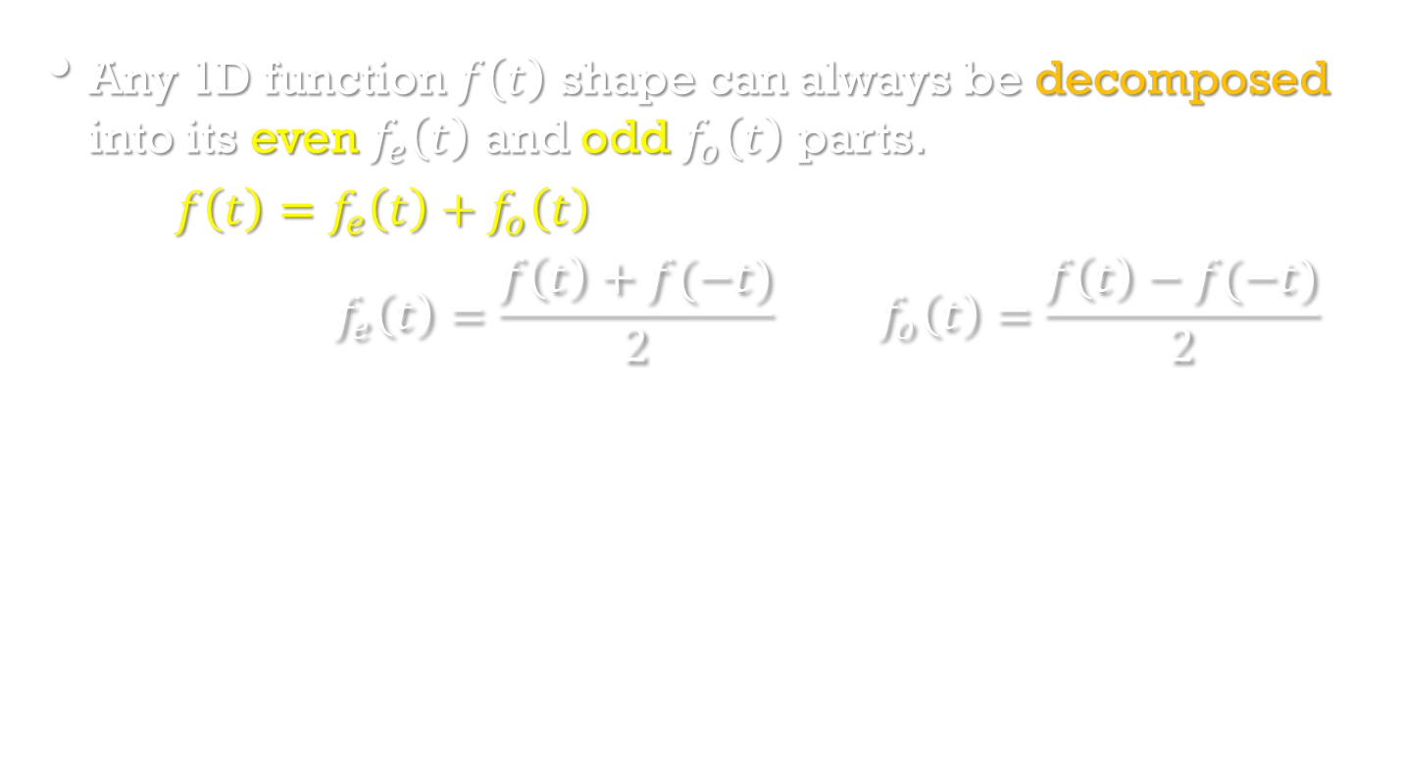
1D Fourier transform
Image Processing, Analysis, and Machine Vision, 4th Edition Sonka, Hlavac & Boyle
Any 1D function $f\left(t\right)$ shape can always be decomposed into its even $f_{e}\left(t\right)$ and odd $f_{o}\left(t\right)$ parts.
$${f\left(t\right)=f}_{e}\left(t\right)+f_{o}\left(t\right)$$
$$f_{e}\left(t\right)=\frac{f\left(t\right)+f(−t)}{2} f_{o}\left(t\right)=\frac{f\left(t\right)−f(−t)}{2}$$

Slide 27
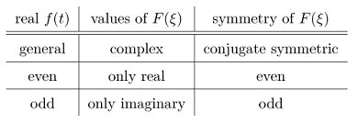
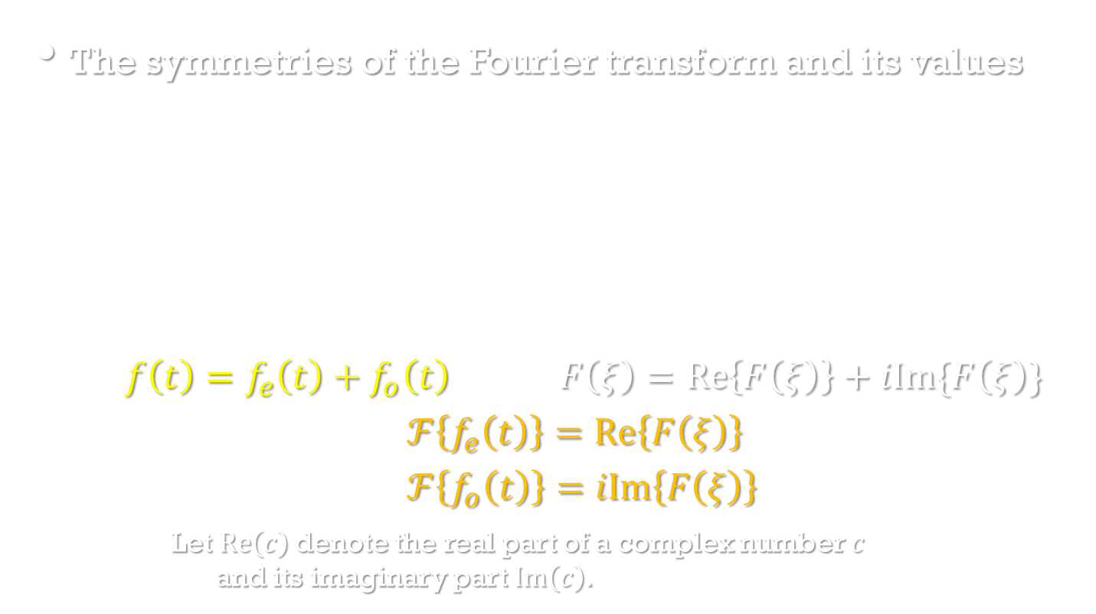
1D Fourier transform
Image Processing, Analysis, and Machine Vision, 4th Edition Sonka, Hlavac & Boyle
The symmetries of the Fourier transform and its values
$${f\left(t\right)=f}_{e}\left(t\right)+f_{o}\left(t\right) F\left(ξ\right)=Re\left\{F\left(ξ\right)\right\}+iIm\{F\left(ξ\right)\}$$
$$ℱ\left\{f_{e}\left(t\right)\right\}=Re\left\{F\left(ξ\right)\right\}$$
$$ℱ\left\{f_{o}\left(t\right)\right\}=iIm\left\{F\left(ξ\right)\right\}$$
Let $Re\left(c\right)$denote the real part of a complex number $c$ and its imaginary part $Im\left(c\right)$.

Slide 28
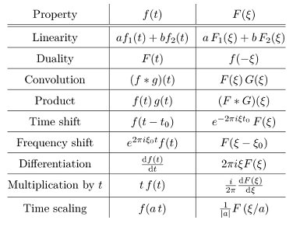
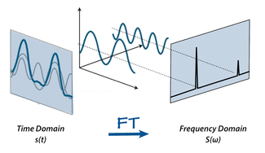
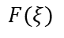
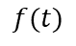
1D Fourier transform
Image Processing, Analysis, and Machine Vision, 4th Edition Sonka, Hlavac & Boyle
The properties of the Fourier transform
$$f(t)$$
$$F(ξ)$$
http://mriquestions.com/fourier-transform-ft.html

Slide 29
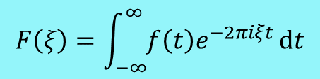
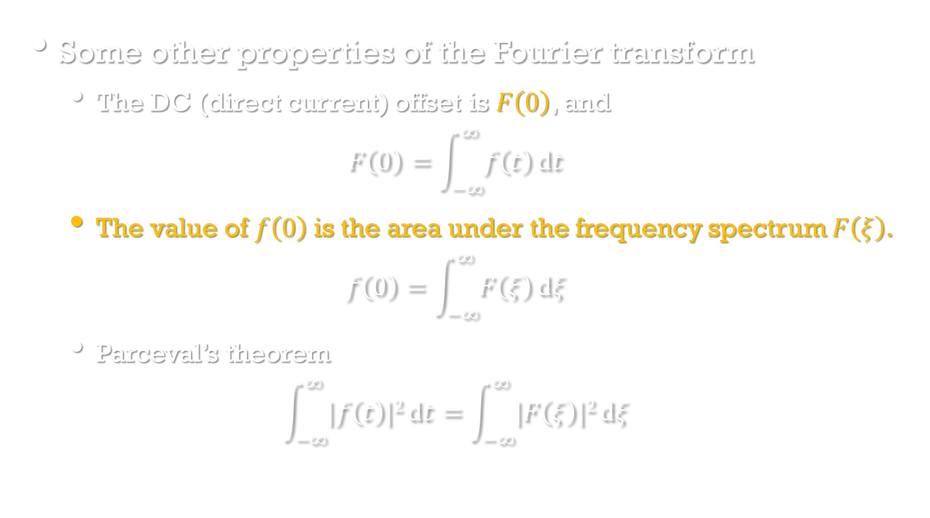

1D Fourier transform
Image Processing, Analysis, and Machine Vision, 4th Edition Sonka, Hlavac & Boyle
Some other properties of the Fourier transform
The DC (direct current) offset is $F\left(0\right)$, and
$$F\left(0\right)=\int_{−∞}^{∞}{f\left(t\right)}dt$$
The value of $f\left(0\right)$is the area under the frequency spectrum $F\left(ξ\right)$.
$$f\left(0\right)=\int_{−∞}^{∞}{F\left(ξ\right)}dξ$$
Parceval’s theorem
$$\int_{−∞}^{∞}{|f\left(t\right)|2}dt=\int_{−∞}^{∞}{|F\left(ξ\right)|2}dξ$$
$$F\left(ξ\right)=\int_{−∞}^{∞}{f\left(t\right)e^{−2πiξt}}dt$$
$$f\left(t\right)=\int_{−∞}^{∞}{F\left(ξ\right)e^{2πiξt}}dξ$$

Slide 30

1D Fourier transform
Image Processing, Analysis, and Machine Vision, 4th Edition Sonka, Hlavac & Boyle
Some examples

Slide 31

Image Processing, Analysis, and Machine Vision, 4th Edition Sonka, Hlavac & Boyle

Slide 32

Image Processing, Analysis, and Machine Vision, 4th Edition Sonka, Hlavac & Boyle

Slide 33



The Fourier Transform of Functions of One Continuous Variable
The Fourier transform of the function in Figure 4.4 (a)
$$F\left(μ\right)=\int_{−∞}^{∞}{f\left(t\right)e^{−j2πμt}}dt=\int_{−W/2}^{W/2}{Ae^{−j2πμt}}dt=\frac{−A}{j2πμ}{\left[e^{−j2πμt}\right]}_{−W/2}^{W/2}=\frac{−A}{j2πμ}\left[e^{−jπμW}−e^{jπμW}\right]=\frac{A}{j2πμ}\left[e^{jπμW}−e^{−jπμW}\right]=AW\frac{sin⁡(πμW)}{(πμW)}$$
$$sinc\left(m\right)=\frac{sin⁡(πm)}{(πm)}$$
where $sinc\left(0\right)=1$
$$Fourier spectrum$$
$$\int{e^{ax}dx}=\frac{e^{ax}}{a}+C$$
$$\sin{θ=(e^{jθ}−e^{−jθ})/2j}$$

Slide 34


The 2D Sinc function

Slide 35

1D Fourier transform
Image Processing, Analysis, and Machine Vision, 4th Edition Sonka, Hlavac & Boyle
Let $Re\left(c\right)$denote the real part of a complex number $c$ and its imaginary part $Im\left(c\right)$.
The formulas describing four function spectrum definitions are as follows:
Complex spectrum $F\left(ξ\right)=Re\left(F\left(ξ\right)\right)+iIm\left(F\left(ξ\right)\right)$
Amplitude spectrum $|F\left(ξ\right)|=\sqrt{Re\left(F2\left(ξ\right)\right)+Im\left(F2\left(ξ\right)\right)}$
Phase spectrum $φ\left(ξ\right)=arctan⁡(\frac{Im\left(F\left(ξ\right)\right)}{Re\left(F\left(ξ\right)\right)})$, if defined.
Power spectrum $P\left(ξ\right)=|F\left(ξ\right)|2=Re\left(F\left(ξ\right)\right)2+Im\left(F\left(ξ\right)\right)2$

Slide 36

1D Fourier transform
Image Processing, Analysis, and Machine Vision, 4th Edition Sonka, Hlavac & Boyle
Discrete Fourier Transform (DFT)
Given discrete signals $f\left(n\right), n=0,1,..,N−1$
The discrete Fourier transform
$$F\left(k\right)=\frac{1}{N}\sum_{n=0}^{N−1}{f\left(n\right)exp⁡(−2πi\frac{nk}{N})}$$
Inverse Fourier transform
$$f\left(n\right)=\sum_{k=0}^{N−1}{F\left(k\right)exp⁡(2πi\frac{nk}{N})}$$
The spectrum $F\left(k\right)$ is periodically extended with period $N$.

Slide 37

2D Fourier transform
$f(x)$ $F\left(ξ\right)$
FT
FT
FT

Slide 38




Image representation and image analysis task
Both representations contain exactly the same information.
Human observer v.s. machine recognizer

Slide 39
Selective Filtering
http://slideplayer.com/slide/8267284/

Slide 40

Selective Filtering
Notch reject filters
Notch pass filters

